Slide 1
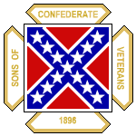
“On to Brazil" Confederate Emigration after the War for Southern Independence
Presented by Marc Robinson
John H. Reagan Camp #2156, Palestine, Texas
Texas Division
Sons of Confederate Veterans

Slide 2
The War for Southern Independence, 1861-1865
Much has been written and said since the end of the War for Southern Independence – It is America’s bloodiest and most disheartening war.
Some wrote who wished to preserve the truth.
Others wrote to distort or change the truth.
Few in our country today, realize that this illegal War waged on the Confederate States took more lives than all of America's other wars together.
More than 750,000 soldiers and sailors lives taken and also the lives of approximately 50,000 Southern civilians.
And, it totally ruined the Southern economy.
The scars would take decades to heal.
Notes:
Death Toll from Lincoln's War Rises
For 110 years, the numbers stood as gospel: 618,222 men died in the Civil War, 360,222 from the North and 258,000 from the South — by far the greatest toll of any war in American history. But new research shows that the numbers were far too low. By combing through newly digitized census data from the 19th century, J. David Hacker, a demographic historian from Binghamton University in New York, has recalculated the death toll and increased it by more than 20 percent — to 750,000. The new figure is already winning acceptance from scholars. Civil War History, the journal that published Dr. Hacker’s paper, called it “among the most consequential pieces ever to appear” in its pages. And a pre-eminent authority on the era, Eric Foner, a historian at Columbia University, said: “It even further elevates the significance of the Civil War and makes a dramatic statement about how the war is a central moment in American history. It helps you understand, particularly in the South with a much smaller population, what a devastating experience this was.” The old figure dates back well over a century, the work of two Union Army veterans who were passionate amateur historians: William F. Fox and Thomas Leonard Livermore. Fox, who had fought at Antietam, Chancellorsville and Gettysburg, knew well the horrors of the Civil War. He did his research the hard way, reading every muster list, battlefield report and pension record he could find. In his 1889 treatise “Regimental Losses in the American Civil War, 1861-1865,” Fox presented an immense mass of information. Besides the aggregate death count, researchers could learn that the Fifth New Hampshire lost more soldiers (295 killed) than any other Union regiment; that Gettysburg and Waterloo were almost equivalent battles, with each of the four combatant armies suffering about 23,000 casualties; that the Union Army had 166 regiments of black troops; and that the average Union soldier was 5 feet 8 1/4 inches tall and weighed 143 1/2 pounds. Fox’s estimate of Confederate battlefield deaths was much rougher, however: a “round number” of 94,000, a figure compiled from after-action reports. In 1900, Livermore set out to make a more complete count. In his book, “Numbers and Losses in the Civil War in America, 1861-65,” he reasoned that if the Confederates had lost proportionally the same number of soldiers to disease as the Union had, the actual number of Confederate dead should rise to 258,000. And that was that. The Fox-Livermore numbers continued to be cited well into the 21st century, even though few historians were satisfied with them. Among many others, James M. McPherson used them without citing the source in “Battle Cry of Freedom,” his Pulitzer-winning 1988 history of the war. Enter Dr. Hacker, a specialist in 19th-century demographics, who was accustomed to using a system called the two-census method to calculate mortality. That method compares the number of 20-to-30-year-olds in one census with the number of 30-to-40-year-olds in the next census, 10 years later. The difference in the two figures is the number of people who died in that age group. Pretty simple — but, Dr. Hacker soon realized, too simple for counting Civil War dead. Published census data from the era did not differentiate between native-born Americans and immigrants; about 500,000 foreign-born soldiers served in the Union Army alone. “If you have a lot of immigrants age 20 moving in during one decade, it looks like negative mortality 10 years later,” Dr. Hacker said. While the Census Bureau in 1860 asked people their birthplace, the information never made it into the printed report. As for Livermore’s assumption that deaths from disease could be correlated with battlefield deaths, Dr. Hacker found that wanting too. The Union had better medical care, food and shelter, especially in the war’s final years, suggesting that Southern losses to disease were probably much higher. Also, research has shown that soldiers from rural areas were more susceptible to disease and died at a higher rate than city dwellers. The Confederate Army had a higher percentage of farm boys. Dr. Hacker said he realized in 2010 that a rigorous recalculation could finally be made if he used newly available detailed census data presented on the Internet by the Minnesota Population Center at the University of Minnesota. The center’s Integrated Public Use Microdata Series had put representative samples of in-depth, sortable information for individuals counted in 19th-century censuses. This meant that by sorting by place of birth, Dr. Hacker could count only the native-born. Another hurdle was what Dr. Hacker called the “dreadful” 1870 census, a badly handled undercount taken when the ashes of the war were still warm. But he reasoned a way around that problem. Because the census takers would quite likely have missed as many women as men, he decided to look at the ratio of male to female deaths in 1870. Next, he examined mortality figures from the decades on either side of the war — the 1850s and 1870s — so that he could get an idea of the “normal” ratio of male to female deaths for a given decade. When he compared those ratios to that of 1860-70, he reasoned, he would see a dramatic spike in male mortality. And he did. Subtracting normal attrition from the male side of the equation left him with a rough estimate of war dead. It was a better estimate than Fox and Livermore had produced, but Dr. Hacker made it clear that his was not the final answer. He had made several assumptions, each of which stole accuracy from the final result. Among them: that there were no war-related deaths of white women; that the expected normal mortality rate in the 1860s would be the average of the rates in the 1850s and 1870s; that foreign soldiers died at the same rate as native-born soldiers; and that the War Department figure of 36,000 black war dead had to be accepted as accurate because black women suffered so terribly both during and after the war that they could not be used as a control for male mortality. The study had two significant shortcomings. Dr. Hacker could make no estimate of civilian deaths, an enduring question among historians, “because the overall number is too small relative to the overall number of soldiers killed.” And he could not tell how many of the battlefield dead belonged to each side. “You could assume that everyone born in the Deep South fought for the Confederacy and everyone born in the North fought for the Union,” he said. “But the border states were a nightmare, and my confidence in the results broke down quickly.” With all the uncertainties, Dr. Hacker said, the data suggested that 650,000 to 850,000 men died as a result of the war; he chose the midpoint as his estimate. He emphasized that his methodology was far from perfect. “Part of me thinks it is just a curiosity,” he said of the new estimate. “But wars have profound economic, demographic and social costs,” he went on. “We’re seeing at least 37,000 more widows here, and 90,000 more orphans. That’s a profound social impact, and it’s our duty to get it right.” http://www.nytimes.com/2012/04/03/science/civil-war-toll-up-by-20-percent-in-new-estimate.html?pagewanted=1&_r=1&adxnnl=1&adxnnlx=1333743588-oxZzlMVNEz4gKUZD5rQ3ag

Slide 3
Confederate Descendants in Brazil
An interesting event connected with the War was the
Emigration of Southerners from the South to Brazil following the War.
This was a direct result of the outcome of the War.
It may have included more than 9,000 people.
Those people have left Brazil a community of descendants of Southern immigrants.
Identified in the Portuguese language of Brazil as the "Confederados."
Notes:
For 110 years, the numbers stood as gospel: 618,222 men died in the Civil War, 360,222 from the North and 258,000 from the South — by far the greatest toll of any war in American history. But new research shows that the numbers were far too low. By combing through newly digitized census data from the 19th century, J. David Hacker, a demographic historian from Binghamton University in New York, has recalculated the death toll and increased it by more than 20 percent — to 750,000.

Slide 4
My ancestors who emigrated to Brazil
My Great Great Great Grandfather and Grandmother, William “Bluford” Nettle and Margaret Burleson Nettle immigrated to Brazil in 1866 from their home in Hill County Texas, where they were living and farming at that particular time.
The Grand Lodge of Texas records show that William B. Nettle was a member of the Dawson Masonic Lodge #155 A.F. & A.M. just prior to leaving Texas for Brazil.
The Nettle’s were living in eastern Hill County Texas.
Fred McMillan organized about 100 men and their families from Hill, Navarro, and McLennan Counties that left on a ship from Galveston to set sail for Brazil and a fresh start.
They simply did not want to live under a “Yankee regime,” as they called it.
Notes:
Charles Marc Robinson, SCV member in the John H. Reagan Camp 2156, Palestine, Texas is the GGG grandson of William “Bluford” Nettle and Margaret Burleson Nettle.
“A man by the name of Fred McMillan aroused the citizenship of three counties and fired them to action by his story of South America.”

Slide 5
Writer/researcher Gary Hawkins stated the situation well,
“It’s impossible to exaggerate the harsh feelings of defeated Southerners toward the Northern army. They might have been willing to accept military defeat, but when their families were burned out of their homes, robbed, and left to starve, a deeper resentment began to take hold. A resentment against America itself.

Slide 6
With citizens starving and property in distress, unscrupulous Yankee agents purchased estates at fire-sale prices….Congress piled on by branding 3.5 million Southerners traitors and depriving them of their citizenship. Northern newspapers called for mass hangings. Jefferson Davis was thrown in jail. It’s no wonder that thousands of Southerners began to pack up and flee to almost anywhere else.”

Slide 7
My ancestors who immigrated to Brazil
The Nettle family had four children when they left Hill County, Dave who was 6 years of age, Ewell age 13, Mary age 14, and a 2 year old baby boy who was buried on Galveston Island, a little way from the sea, just prior to setting sail from their Texas homeland.
The Houston Chronicle, on Sunday, October 25, 1931 printed an interview of my GG grandfather, Dave Nettle, who was 6 years old when the family departed Texas for Brazil in 1866.

Slide 8
Sunday, October 25, 1931 THE HOUSTON CHRONICLE

Slide 9
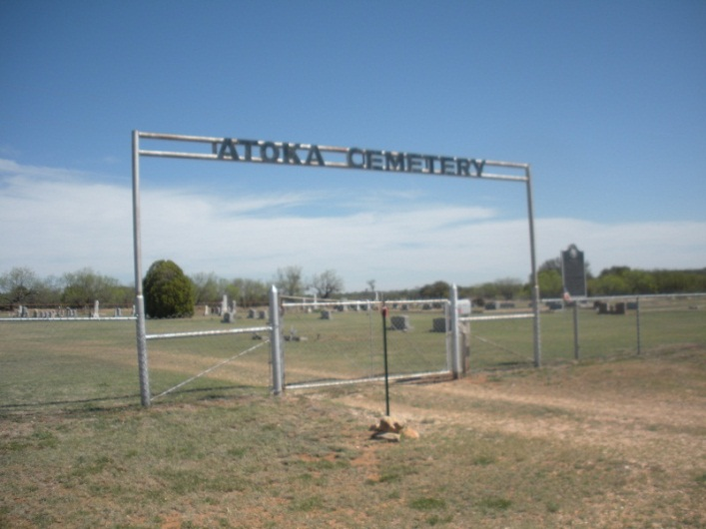
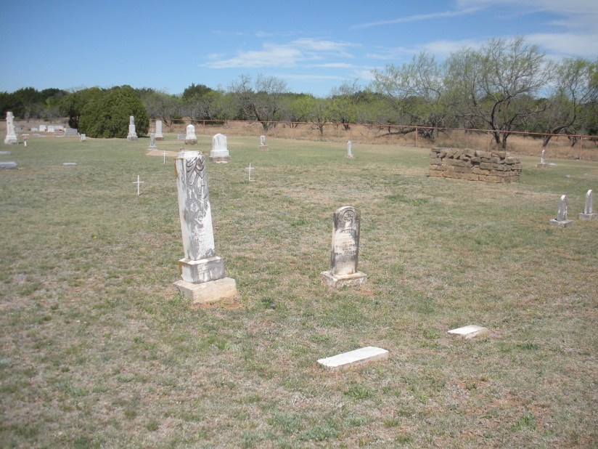
My ancestors who immigrated to Brazil
NETTLE, William B. - Jan 9, 1826 - June 11, 1892 - (MASONIC) Died while visiting his daughter, Mary and her husband Nevill Edenborough in Coleman County, Texas.
W. B. Nettle buried beside his 4 year old granddaughter, Edith Edenborough. (No other family member buried in cemetery.)
Notes:
Photo of Charles “Marc” Robinson next to the grave marker of his GGG grandfather, W. Bluford Nettle, in the Atoka Cemetery in Coleman County. It took Marc several months to figure out where W. Bluford Nettle was buried since it was a long ways from his home.

Slide 10
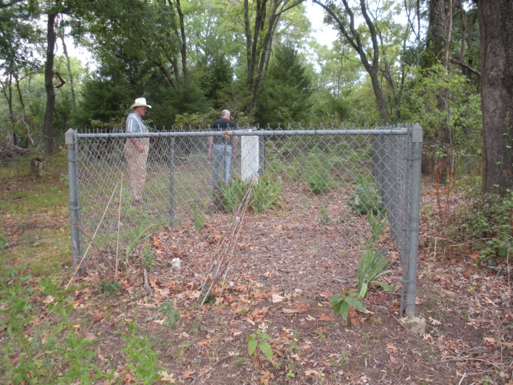
My ancestors who immigrated to Brazil
Nettle Cemetery, approx. 5 miles northwest of Fairfield, Freestone County Texas on Nettle home place. Margaret’s father (my GGGG Grandfather), Hopson Burleson, gave them approximately 350 acres off of Grindstone Creek when they returned from Brazil. This land is located at the south end of Hopson’s Mexican Land Grant he obtained in 1835 a year after arriving in Texas and fighting Indians for Mexican Govt. [His land grant included a league and a labor of land. (4428.4 plus 177.1 acres)]
Notes:
Vara (unit of length)
A vara (meaning "rod" or "pole", abbreviation: var) is an old Spanish unit of length. Varas are a surveying unit that appears in many deeds in the southern United States, and varas were also used in many parts of Latin America. It varied in size at various times and places; the Spanish unit was set at about 835.905 mm (32.91 in) in 1801. In Argentina, the vara measured about 866 mm (34.1 in), and typical urban lots are 8.66 m (28.41 ft) wide (10 Argentine varas). At some time a value of 33 inches (838.2 mm) was adopted in California.
In Texas, a vara was defined as 33+¹⁄₃ inches (846.67 mm), or 1 yard = 1.08 vara. The vara and the corresponding unit of area, the square vara, were introduced in the 19th century to measure Spanish land grants. In Texas, Stephen F. Austin's early surveying contracts required that he use the vara as a standard unit. The vara can be seen in many deeds as late as the mid to late 1900's. An 1 acre (0.405 ha) is equivalent to 5,645.376 Texan square varas. A league is equivalent to 5,000 varas squared or 4,428.4 acres (1,792.11 ha).
To convert varas to feet, take the varas and divide by 0.36.
Standardization of measurement in Texas came with the introduction of varas, cordels, and leagues.
A measure of 100 varas by 100 varas is equal to 7000 meters square, and is known traditionally throughout Latin America as a manzana (i.e., a "city block"). As well, lumber is still measured in Costa Rica using a system based on 4 vara, or 11 feet, for both round and square wood. With square wood, using inches, the width is multiplied by the depth to get a measurement which they call pulgadas, or inches. The lumber is charged 'per inch', which is a measurement 11/12 of a board foot.
[edit] Labor (unit of area)
A labor ( /ləˈbɔr/ in West Texas) is a unit of area, used to express the area of land, that is equal to 1 million square varas. A labor is equivalent to about 177.1 acres (71.67 ha). It was used in the archaic system of old Spanish land grants affecting Texas and parts of adjoining states. The labor is often used as an approximate equivalent to a quarter-section (that is, one quarter of a square mile of land). It is still encountered in modern real estate transactions.

Slide 11
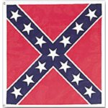
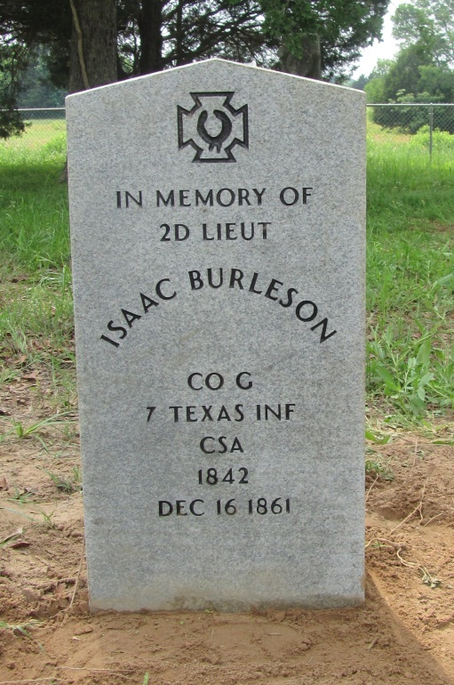
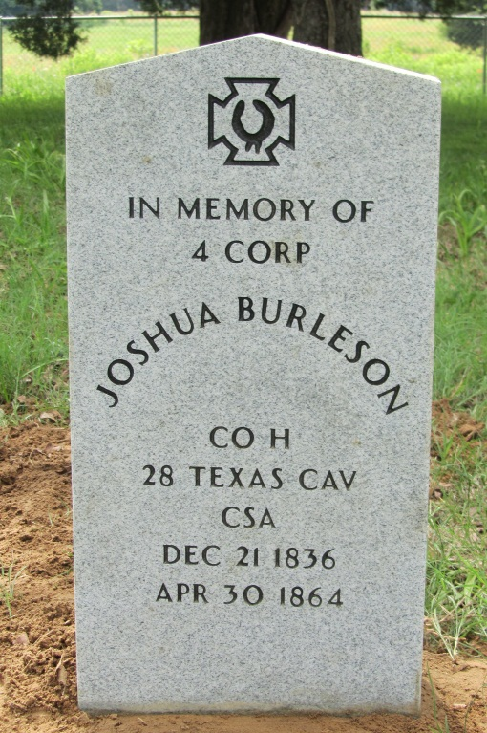
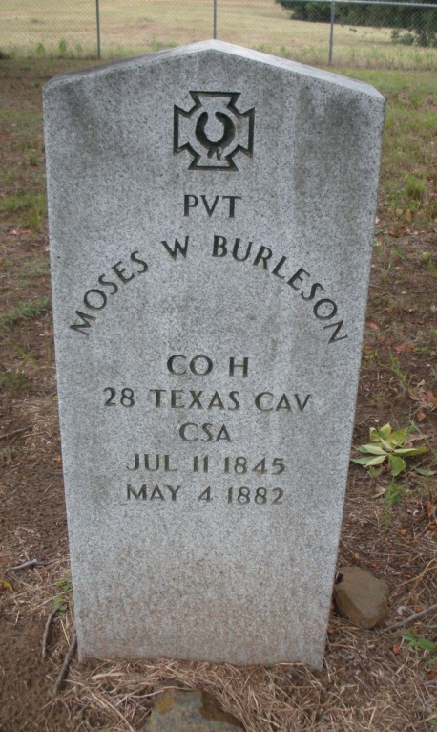
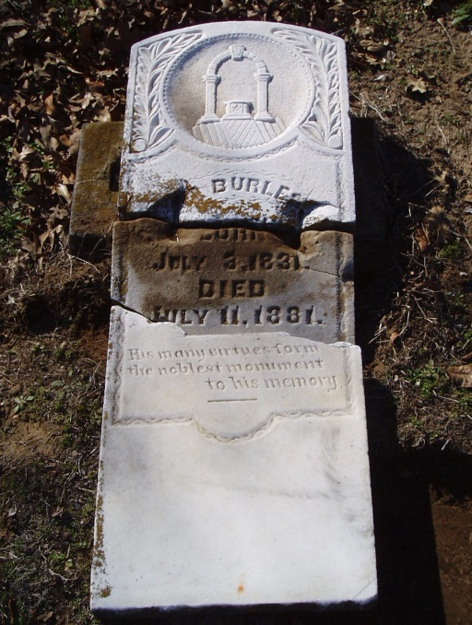
All five younger brothers of my GGG Grandmother, Margaret Burleson Nettle, served in the Confederate States Army. Three never to return home.
Grave markers located at Hopson Burleson Memorial Cemetery, Freestone County Texas

Slide 12
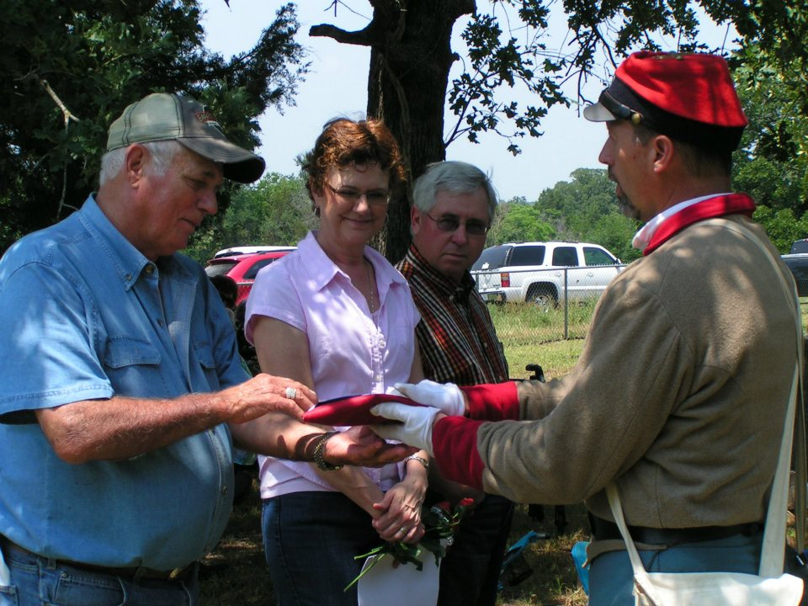
The John H. Reagan Camp 2156 hosted a Four Marker dedication ceremony and three re-interments for Burleson Brothers at Hopson Burleson Memorial Cemetery in Freestone County Texas on May 5, 2012
Notes:
Photo in upper right is of Camp Commander Marc Robinson presenting one of the flags draping over a newly dedicated grave marker to an older descendant of one of Margaret Burleson Nettle’s brothers. Words used when making these flag presentations is, “On behalf of President Jefferson Davis and a grateful nation, we present to you a token of our appreciation for the service of your ancestor.”

Slide 13
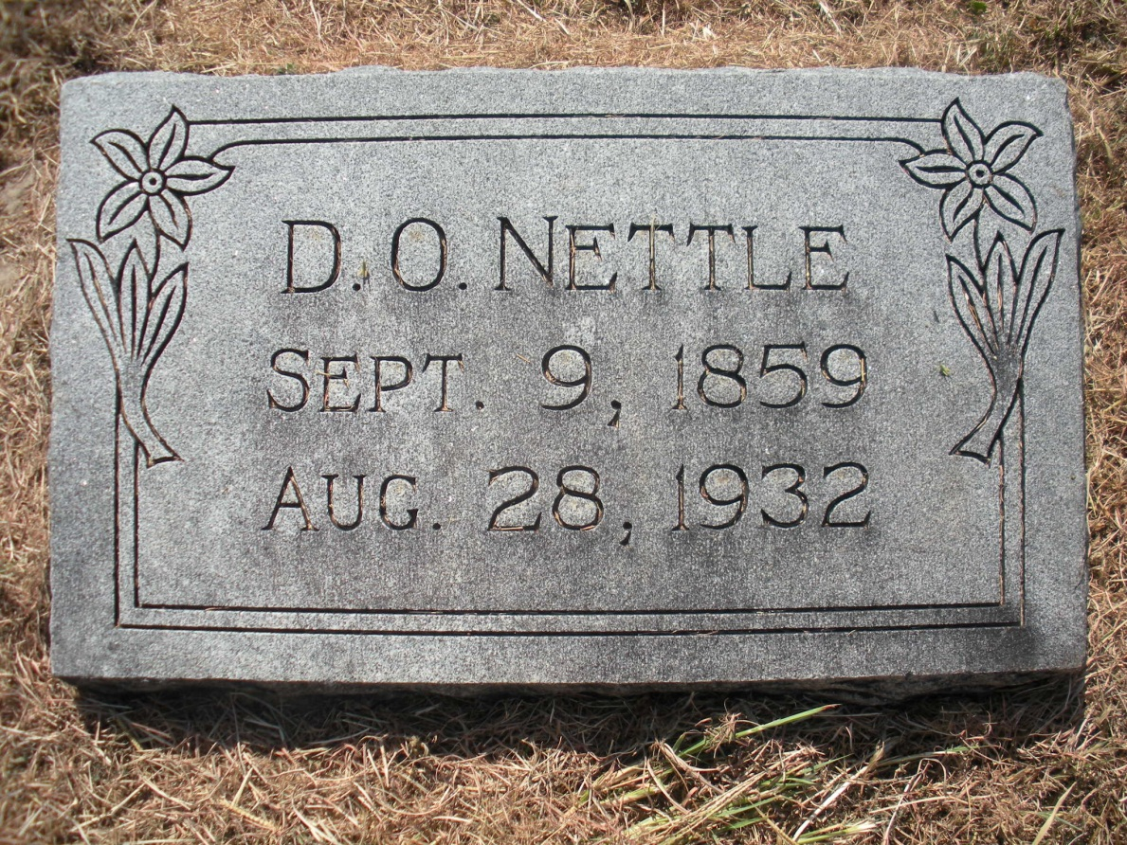
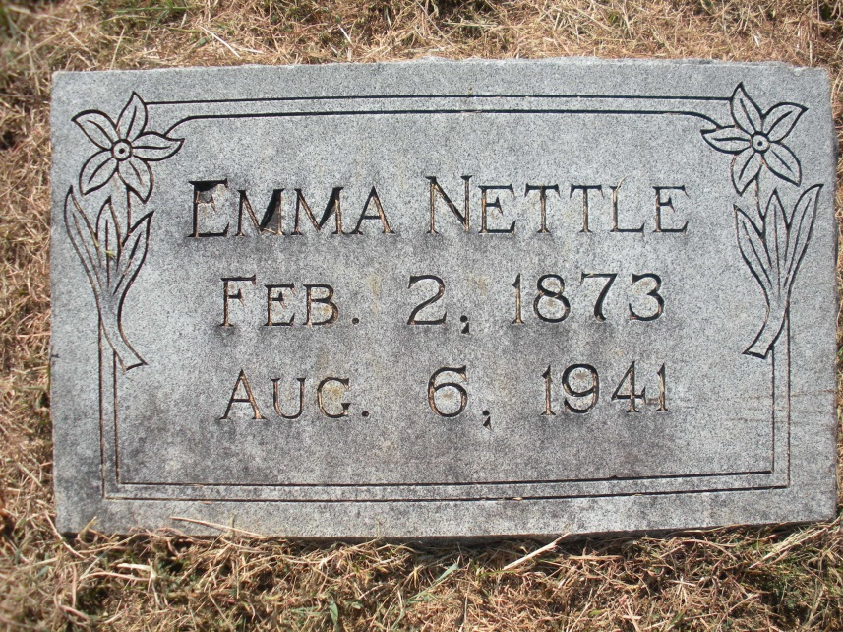
My ancestors who immigrated to Brazil
Dave (D. O.) Nettle was 6 years old in 1866 when the Nettle family left Galveston, Texas for Brazil. He was 21 when he returned. He and his wife, Emma Harris Nettle are buried in the Cade Cemetery Freestone County Texas just west of Streetman, Texas.

Slide 14
Confederate Descendants in Brazil
Descendants are all over the country of Brazil.
The largest community, and by far the most important is located in the State of São Paulo.
This community, founded by the Southerners, has grown into the town of “Americana.”
It’s older mother city, Vila Santa Bárbara (today Santa Bárbara D'Oeste), is only a few miles apart.
These two cities are the gravity center of the community of Southern descendants in Brazil.
Since 1954, the Fraternity of American Descendants has headquartered there.
Notes:
The immigrants bought land in the State of São Paulo at 22 cents an acre, and in the States of Pará, Espírito Santo, Bahia, Rio de Janeiro and Santa Catarina; some went to Santarém, Pará State, the Vale do Rio Doce region as well as to Iguape and most to Vila Santa Bárbara. The community that grew up around Vila Santa Bárbara was the most important and would grow into Americana, now an important textile center.

Slide 15
Confederate Battle Flag Posted at the Campo Cemetery http://goo.gl/maps/pjzCS

Slide 17
The immigrants bought land in the State of São Paulo at 22 cents an acre, and in the States of Pará, Espírito Santo, Bahia, Rio de Janeiro and Santa Catarina; some went to Santarém, Pará State, the Vale do Rio Doce region as well as to Iguape and most to Vila Santa Bárbara.
The community that grew up around Vila Santa Bárbara was the most important and would grow into Americana, now an important textile center.
Source: Os Confederados web site http://confederados.com.br/

Slide 20
Confederate Descendants in Brazil
The descendants gather at the Campo Cemetery every quarter session of the year, on its second Sunday, for a religious service, a discussion of topics related to Fraternity, and a traditional lunch.
Each family brings dishes, desserts, drinks and all present enjoy Brazilian and Southern favorites in a communal style, Examples Southern favorites include frango frito (fried chicken), salada repolho (coleslaw), and pudim de banana (guess).
The old-timers chat in the familiar Southern drawl, while children run and play, speaking Portuguese and very little English
There is also the annual Festa Confederada, a fund raising event to support the maintenance of the Campo Cemetery.

Slide 21
Flyer for the 2014 Confederate Festa in Brazil

Slide 22
The Festa dos Confederados
Flags are raised during the Festa; the Brazilian flag, the Confederate Battle flag, and two other flags are raised near the patio as the Brazilian national anthem is played.
When the flags are up, a tribute to the Confederacy begins.
A type of Miss Teen pageant with Miss Tennessee, Miss Georgia, etc. parade through with there Confederate uniformed escorts.
Announcements, presentations, and awards are given as the girls are changing their dresses for a new dance.
Then the same girls with the same escorts dance the Virginia Reel, a waltz, a square dance to Dixie, line dances set to Irish type music.

Slide 23
The Festa dos Confederados
Boys in Confederate uniforms.
Girls in hoop skirts.
Girls will all change to pastel yellow dress and as they re-enter to dance, the music that plays is the Yellow Rose of Texas.
These young ladies are daughters of prominent leaders and many are in college.
The Festa coordinators are accomplished professionals, engineers, prominent surgeons, some holding advanced degrees in sociology and cultural anthropology, etc.

Slide 34
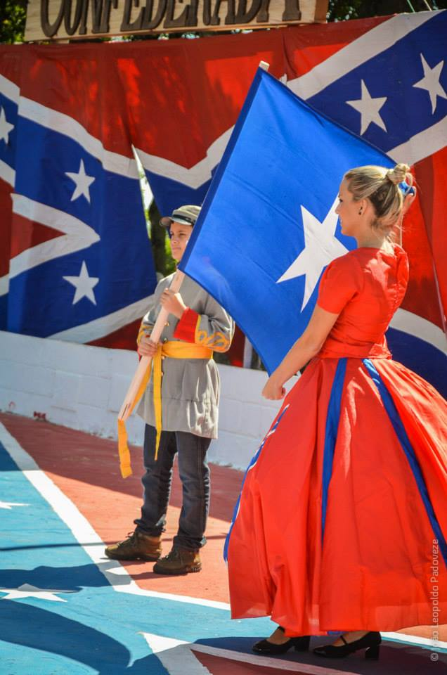

Slide 36
The Festa dos Confederados
Many original Confederados were planters, but many were also doctors, teachers, dentists, machinists, etc. all with a fierce work ethic.
Interviewed by a journalist at one of the recent Festas, one young 20 year old dancer, Danielle, daughter of the president of the Fraternity, of American Descendants stated in an interview that she was in her third year of law school.
She also stated that she was proud of her heritage and wanted to be buried along side her ancestors in the Campo Cemetery.

Slide 37
The Campo Cemetery
The Campo Cemetery is located in the countryside
Surrounded by sugar cane fields
10 miles from Americana and Santa Bárbara D´Oeste
100 miles from São Paulo, Brazil's largest city and capital of São Paulo State

Slide 39
The Campo Cemetery
The inscription found on the tombstone of Confederate Veteran, Napoleon Bonaparte McAlpine, who rests together with a number of other Confederate Veterans and Confederados leaders in the Campo Cemetery:
"Soldier rest! Thy warfare o´er Sleep the sleep that knows no breaking Days of toil or nights of waking"

Slide 40
The Campo Cemetery
There are many more Confederados with military history and there are those who have no military history who immigrated to Brazil and now rest in the Campo Cemetery.

Slide 41
The Campo Cemetery
The Campo Cemetery, later to become the spiritual center of the Confederate colony in Brazil.
The Campo Cemetery was the unofficial cemetery of the community.
Notes:
God’s Acre – Yard associated with a church

Slide 42
The Campo Cemetery
In 1955, the Fraternity of American Descendants was founded, in part to maintain the cemetery.
After many years, a Mr. Sonny Pyles donated the plot legally to the Fraternity.
Many say that Campo Cemetery feels more like a garden than a graveyard and that there is as much life as death there.
Campo Cemetery has many different species of trees, from banana, pine, copaiba, coconut, caryota palms, and many others.

Slide 43
The Campo Cemetery

Slide 44
An old Grave marker in the Campo Cemetery

Slide 45
Old Grave Marker in the Campo Cemetery

Slide 46
Today the Campo Cemetery is the testament of the most successful Southern colony founded after the War for Southern Independence.

Slide 48
Campo Cemetery Sir Names
The following list shows family names in the Campo Cemetery, at Santa Barbara D'Oeste, Brazil: Anderson Dozier Knuse Rainey Armstrong Drain Kolger Ralston Ashee Dresback Kolb Ransom Ayers Dumas Kollinger Rast Bagby Dunn Kramer Rean Baird Dyer Landers Rhome Bankston Easton Lane Riker Barnsley Ellis Lang Ritter Barr Emmett LeConte Roussel Baujahn Emerson Linden Rowe Beasley Ezelle Linn Russell Bentley Falwood Lloyd Sampson Berney Fahay McAlpine Sanders Blackford Farley McCann Schofield Bloxom Feagin McDade Scurlock Blue Fenley McDonald Seawright Boeringer Ferguson McEachin Sexton Bookwalter Fielder McFadden Seymour Bowen Fife McIntyre Shares Boyd Fletcher McGee Sharpley Braxton Frelder McKnight Shaw Britt Foster McMullan Shippey Broadnax Fox McNabb Slaughter Brooks Freleigh Malone Smith Brown Gammon Marchant Sparks Brownlow Gannon Mason Spencer Bruce Garlington Massey Stamply Bryant Garner Mastiff Steagall Buchanan Gaston Maston Steele Budd Gates Mathews Stewart Buford German Maxwell Stiel Buhlow Gill Mendenhall Stone Bulfatin Gilmore Meriwether Stow Bunnel Guillet Miller Strong Burns Glenn Mills Stuk Burrand Godfrey Minchin Swain Burton Gottschalk Moncrief Tanner Byington Grady Moore Tarver Campbell

Slide 49
Campo Cemetery Sir Names
Graham Morgan Taylor Capps Green Morrison Terrell Carlton Gunter Morton Thatcher Carson Hall Murphy Thomas Carter Hanny Myers Thompson Cencir Hanson Nathan Tilly Censon Hardeman Nelius Tobin Chaffie Hardis Nettles Tovamjer Chamberlain Hargrove Newman Townsend Cherry Harris Nichols Trigg Clark Harrison Nollens Turner Clayburn Harvey Norris Vaughn Coachman Hastings Northrup Vellaky Cobb Hawthorne Odell Vincent Cogburn Heinsman Oliver Waddell Cole Henderson Owen Wade Colter Henington Paine Wallace Cook Hickman Parcher Ward Combs Hogan Parker Warne Cottingham Holland Parks Warson Coulter Howard Patterson Watson Cowley Howell Peacock Watts Crawley Howes Penn Weaver Crovey Hunter Perkins Webster Crisp Isaacs Peter Weingeutter Cullen Jackson Peterson Weissinger Currie James Pettigrew Wells Daguerre Jennings Philips Wesson Daniel Johnson Pichowski Wharton Dascomb Joiner Pierce Whitman Darvile Jones Pinkney Whitaker Davis Judkins Pitts White Demaret Keese Platt Whitehead DeYambert Keeps Porter Wright Dickie Keith Prestridge Williamson Dickson Kemper Proston Wingeter Dillard Kennedy Provost Wise Dire Kennerly Pyles Wiggins Dobbins Kernan Quillen Wood Dodson Kerr Quilly Wright Doherty Keyes Radcliff Yancey Domm King Rader Young Dowds Kirk Radig
Source: The Lost Colony of the Confederacy, by Eugene Harter

Slide 50
Early 1900 quarterly reunion at the Campo Cemetery
Notes:
Source: http://www.youtube.com/watch?v=L2LLM38bHDY

Slide 51
Confederates in Brazil
The most prominent and the real founder of the Confederate colony was:
Colonel William Hutchinson Norris, a native of Oglethorpe, GA who had moved to Alabama and later served as a State Senator.
He was a Freemason (past Grand Master) a lawyer and is mentioned in the book "Reminiscences of Public Men of Alabama“
He was a veteran of the Mexican War and was in his sixties when the War Between the States raged.
His sons, Reece, Frank, Robert and Clay, all served in the Confederate Army.

Slide 52
Confederates in Brazil
At age 65, Colonel Norris declared that although he knew nothing of the Brazilian culture or its language, he was “just mad enough to give it go.”
Therefore, when the carpetbaggers swarmed into the South at the close of War, Colonel Norris made his way to Brazil.

Slide 53
Casa dos Norris - First home built by Confederados in Brazil

Slide 54
Confederates in Brazil
Brazil’s Emperor Dom Pedro II welcomed many of the Southerners in person there, thanks to contacts Colonel Norris had with the Masons and to Brazil's need of agricultural skills of the Southern planters, especially in cotton farming.
The following four slides relate to the Masonic aspect of the emigration after the War.
Notes:
154 Masonic Families Founded A City Of 170,000 In Brazil Walter J. Klein, 32° 5009 Gamton Court Charlotte, NC 28226-7920
The entrance to Americana, a Brazilian city founded in 1865 by Confederate emigrants, most of them Freemasons, is marked by a large Square and Compasses monument with descriptive plaque. Cast of Characters, All Masons: Dom Pedro II, last Emperor of Brazil William Hutchinson Norris, Colonel in the Mexican War, Alabama State Senator, and Grand Master Unknown Union officer who, because of a widow’s use of a Masonic sign, saved the gold buried by Colonel William Norris Charles Nathan, British merchant in Rio Tavares Bastos, adviser to the Emperor of Brazil Joachim Maria Saldaña Mariño, Grand Master of the Emperor Dom Pedro’s branch of Freemasonry Dr. Russell McCord, whose certificates prove the Masonic-Brazilian partnership And these non-Masons: Patrick Fields, North Carolinian teacher, who recently rediscovered a Brazilian city of 170,000 founded in 1865 by Confederate Masons William Lowndes Yancey, Senator from Alabama, Confederate firebrand, and “Voice of the Secession” Margaret Mitchell, author of Gone with the Wind, who put it in Scarlet O’Hara’s head to flee to Latin America General Robert E. Lee, who urged Confederates not to move to Brazil ....Surviving Confederate soldiers returned home to families in misery, their livestock consumed, money worthless, railroads and factories destroyed, boats swept from their waters, clothes and food gone. When some of these who were Masons heard of a “New South” with undeveloped land for 22 cents an acre, its emperor a Brother Master Mason, and better cotton than North America’s, they packed up and moved to Brazil. We know at least 154 families began the migration in 1865 from Texas, Alabama, and South Carolina to Brazil, and between 2,000 and 4,000 more moved to Brazil during the next 10 years. ....One was Colonel William H. Norris who had a small fortune in gold buried in his Perry County, Alabama, yard. A Union officer stopped his men from digging it up after Norris’s wife shook the officer’s hand Masonically. With that gold, Colonel Norris bought 500 acres and established an infant community. That spot in Brazil was to become the largest Confederate settlement in South America. It is near Santa Barbara, southeast of the city of Sao Paulo, Brazil. ....Norris and his Brethren founded George Washington Lodge in their little village that was soon named Americana by their neighbors. What began this exodus as a Masonic event in history? Actually, a Mason named Robert W. Lewis of Virginia wrote Robert E. Lee asking his opinion about Confederates leaving the country. Lee answered, “The South requires the presence of her sons…to sustain and restore her.” Then he wrote, “In answer to your question as to what portion I hold in the order of Masons, I have to reply that I am not a Mason and have never belonged to the society.” ....Lewis and other Masons knew Freemasonry was alive and well in Brazil, living hand-in-glove with its Protestant community, especially Presbyterians. Encouragement came from Brother Charles Nathan, a member of the Brazilian immigration society who helped arrange passage for Southerners via New Orleans. Nathan was a British merchant in Rio de Janeiro who had lived in New Orleans, Louisiana. He apparently worked with Reverend Ballard S. Bunn who led migrants to another colony near Americana. Dom Pedro II, Emperor of Brazil, a Freemason whose father was a Grand Master, is pictured here as a young man.
....The most encouragement, though, came from Brother Taveres Bastos, founder of the immigration society and confidant of the Emperor of Brazil whose father, Dom Pedro I, was Grand Master. His close friend was Reverend James Cooley Fletcher, Presbyterian minister and First Secretary of the U. S. Legation in Brazil. Together, they had the ears of intellectuals, educators, statesmen, liberals, and the Emperor himself. They actively promoted close United States–Brazil relations, including migration and agricultural/industrial development. When Confederate Masons communicated their distress, these leaders were ready to help. ....Joachim Maria Saldaña Mariño was a friend of Taveres Bastos. He was a co-editor of a liberal Rio newspaper. Mariño was Grand Master of the Grande Oriente do Brasil ao Vale dos Beneditinos, the Emperor’s branch of Freemasonry. Happily, he was also President of Sao Paulo, the province where Americana was born and flourished. ....Dr. Russell McCord was a migrant from Alabama who settled in the town of Macaé. Saldaña Mariño signed McCord’s Masonic certificates for the years 1872, 1874, 1875, and 1879. These documents comprise the best records of the U.S. Confederate Masonic–Brazilian partnership. Scottish Rite Masons will be particularly attracted to Saldaña Mariño because of his activity in the mid-1860s in the cause of separation of church and state.
A Confederate grave in the Brazilian city of Americana bears a prominent Square and Compasses.
....Dr. McCord’s Masonic documents are historic in another way. A second signer was the eminent José Maria da Silva Paraños, best known as the Visconde do Rio Branco. He was Grand Master of the Grande Oriente do Brasil, and he was the author of the first emancipation legislation that led, 17 years later, to abolition of slavery in his nation. What was life like for former Southerners in Portuguese-speaking Brazil? In fact, half the Confederate North Americans quit and went home within ten years. But the rest stuck it out nobly and left a heritage that lives today, albeit as a small minority among the 170,000 citizens of Americana. ....Patrick Fields of Charlotte, North Carolina, has ancestors who fought in both the Revolution and Confederacy. His father and grandfather were Freemasons. He taught several weeks in the Sao Paulo region last summer and made it his business to investigate Americana. There he found a burgeoning metropolis populated mostly by people of Italian heritage spilling over from South America’s largest city, Sao Paulo. He noted, “The people in Americana are like those all over Brazil: all colors, all religions, all occupations, all heritages.”
The Confederate Museum in the city of Americana, Brazil, has a panel discussing Freemasonry as it played a part in founding that city in 1865.
....Masonic Lodges abound in Brazil. Masonic, like Confederate, activity surfaces in Americana at their Confederate museum, cemetery, and frequent festivals which Fields videotaped extensively. He said, “Masons and other Confederates were never locked into Americana or other settlements. They spread all over Brazil. So you can’t say today’s people of Americana are descended from Confederate Masons.” ....What did these remarkable Masons bring to Brazil? Well, watermelons for one thing. Grown from their American seed, watermelons became so popular that up to 100 railroad carloads a day were shipped from Americana by the late 1800s. The Confederate Masonic families had no trouble raising meat, vegetables, and fruit to feed their families. Their dishes included corn bread, spoon bread, egg bread, biscuits, and burgoo stew, a savory mixture of several kinds of meat and vegetables usually served at political rallies and community occasions. Black-eyed peas, potatoes, and Southern-fried chicken live on in Brazil. Brazilian desserts include such Southern staples as vinegar pie, ambrosia, custard, fruit pies, chess pie, and ginger cake. ....The immigrants introduced the plow and improved farming methods that increased cotton, coffee, and sugarcane crop yields nationwide. Brazil hired North Americans as advisers and plantation administrators. These Confederados, as they were called, got much in return. The Halls, Thatchers, Gastons, and other Confederados netted a 100% return on their first two-year cotton planting. They were able to build their Old South mansions again, though in Brazil. And they regained pride in their heritage. They felt they were Americans deep inside. Their undying respect for Jefferson Davis and Robert E. Lee simply added to their fraternal bonds to George Washington, Benjamin Franklin, James Monroe, Andrew Jackson, and the spirit of freedom of the United States of America. ....The validity of this information can be proved by reading two books: The Confederados published by the University of Alabama Press, and The Lost Colony of the Confederacy published by the University Press of Mississippi. Or, better still, take the next plane to Sao Paulo and visit Americana!
Walter J. Klein is a member of Excelsior Lodge No. 261 in Charlotte, N.C., and the Scottish Rite Bodies of Charlotte. He was producing and donating motion pictures for the Shrine Bowl of the Carolinas years before he petitioned for the Degrees. Presently creating a mini-museum at the Charlotte Scottish Rite Temple displaying “Treasures of Charlotte Masonry,” he discovered the Hezekiah Alexander House was built as a Masonic meeting hall and believes it to be the oldest Masonic structure in America. He conceived and built The American Freedom Bell and, with the Grand Lodge of North Carolina, arranged for its cornerstone to be laid by both white and black Grand Masters before a crowd led by Governor Jim Martin. A member of the Scottish Rite Research Society, he received in 2000 the highest Masonic award in North Carolina, the Joseph Montford Medal, for his services to Freemasonry and America.

Slide 55
Walter J. Klein, a mason from North Carolina wrote the following in a well researched article:
“Surviving Confederate soldiers returned home to families in misery, their livestock consumed, money worthless, railroads and factories destroyed, boats swept from their waters, clothes and food gone. When some of these who were Masons heard of a “New South” with undeveloped land for 22 cents an acre, its emperor a Brother Master Mason, and better cotton than North America’s, they packed up and moved to Brazil. We know at least 154 families began the migration in 1865 from Texas, Alabama, and South Carolina to Brazil, and between 2,000 and 4,000 more moved to Brazil during the next 10 years… (continued)
Notes:
The immigrants bought land in the State of São Paulo at 22 cents an acre, and in the States of Pará, Espírito Santo, Bahia, Rio de Janeiro and Santa Catarina; some went to Santarém, Pará State, the Vale do Rio Doce region as well as to Iguape and most to Vila Santa Bárbara. The community that grew up around Vila Santa Bárbara was the most important and would grow into Americana, now an important textile center. Source: Os Confederados web site http://confederados.com.br/

Slide 56
(continued from previous slide)
…[Col.] Norris and his Brethren founded George Washington Lodge in their little village that was soon named Americana by their neighbors…
…What began this exodus as a Masonic event in history? Actually, a Mason named Robert W. Lewis of Virginia wrote Robert E. Lee asking his opinion about Confederates leaving the country…
(continued)

Slide 57
(continued from previous slide)
…Lewis and other Masons knew Freemasonry was alive and well in Brazil, living hand-in-glove with its Protestant community, especially Presbyterians…
…When Confederate Masons communicated their distress, these leaders were ready to help.”

Slide 58
The entrance to Americana, a Brazilian city founded in 1865 by Confederate emigrants from the South, most of them Freemasons, is marked by a large Square and Compasses monument with descriptive plaque.
Source: Walter J. Klein, 32°, 5009 Gamton Court, Charlotte, NC
Notes:
Cast of Characters, All Masons: Dom Pedro II, last Emperor of Brazil William Hutchinson Norris, Colonel in the Mexican War, Alabama State Senator, and Grand Master Unknown Union officer who, because of a widow’s use of a Masonic sign, saved the gold buried by Colonel William Norris Charles Nathan, British merchant in Rio Tavares Bastos, adviser to the Emperor of Brazil Joachim Maria Saldaña Mariño, Grand Master of the Emperor Dom Pedro’s branch of Freemasonry Dr. Russell McCord, whose certificates prove the Masonic-Brazilian partnership And these non-Masons: Patrick Fields, North Carolinian teacher, who recently rediscovered a Brazilian city of 170,000 founded in 1865 by Confederate Masons William Lowndes Yancey, Senator from Alabama, Confederate firebrand, and “Voice of the Secession” Margaret Mitchell, author of Gone with the Wind, who put it in Scarlet O’Hara’s head to flee to Latin America General Robert E. Lee, who urged Confederates not to move to Brazil ....Surviving Confederate soldiers returned home to families in misery, their livestock consumed, money worthless, railroads and factories destroyed, boats swept from their waters, clothes and food gone. When some of these who were Masons heard of a “New South” with undeveloped land for 22 cents an acre, its emperor a Brother Master Mason, and better cotton than North America’s, they packed up and moved to Brazil. We know at least 154 families began the migration in 1865 from Texas, Alabama, and South Carolina to Brazil, and between 2,000 and 4,000 more moved to Brazil during the next 10 years. ....One was Colonel William H. Norris who had a small fortune in gold buried in his Perry County, Alabama, yard. A Union officer stopped his men from digging it up after Norris’s wife shook the officer’s hand Masonically. With that gold, Colonel Norris bought 500 acres and established an infant community. That spot in Brazil was to become the largest Confederate settlement in South America. It is near Santa Barbara, southeast of the city of Sao Paulo, Brazil. ....Norris and his Brethren founded George Washington Lodge in their little village that was soon named Americana by their neighbors. What began this exodus as a Masonic event in history? Actually, a Mason named Robert W. Lewis of Virginia wrote Robert E. Lee asking his opinion about Confederates leaving the country. Lee answered, “The South requires the presence of her sons…to sustain and restore her.” Then he wrote, “In answer to your question as to what portion I hold in the order of Masons, I have to reply that I am not a Mason and have never belonged to the society.” ....Lewis and other Masons knew Freemasonry was alive and well in Brazil, living hand-in-glove with its Protestant community, especially Presbyterians. Encouragement came from Brother Charles Nathan, a member of the Brazilian immigration society who helped arrange passage for Southerners via New Orleans. Nathan was a British merchant in Rio de Janeiro who had lived in New Orleans, Louisiana. He apparently worked with Reverend Ballard S. Bunn who led migrants to another colony near Americana. Dom Pedro II, Emperor of Brazil, a Freemason whose father was a Grand Master, is pictured here as a young man.
....The most encouragement, though, came from Brother Taveres Bastos, founder of the immigration society and confidant of the Emperor of Brazil whose father, Dom Pedro I, was Grand Master. His close friend was Reverend James Cooley Fletcher, Presbyterian minister and First Secretary of the U. S. Legation in Brazil. Together, they had the ears of intellectuals, educators, statesmen, liberals, and the Emperor himself. They actively promoted close United States–Brazil relations, including migration and agricultural/industrial development. When Confederate Masons communicated their distress, these leaders were ready to help. ....Joachim Maria Saldaña Mariño was a friend of Taveres Bastos. He was a co-editor of a liberal Rio newspaper. Mariño was Grand Master of the Grande Oriente do Brasil ao Vale dos Beneditinos, the Emperor’s branch of Freemasonry. Happily, he was also President of Sao Paulo, the province where Americana was born and flourished. ....Dr. Russell McCord was a migrant from Alabama who settled in the town of Macaé. Saldaña Mariño signed McCord’s Masonic certificates for the years 1872, 1874, 1875, and 1879. These documents comprise the best records of the U.S. Confederate Masonic–Brazilian partnership. Scottish Rite Masons will be particularly attracted to Saldaña Mariño because of his activity in the mid-1860s in the cause of separation of church and state.
A Confederate grave in the Brazilian city of Americana bears a prominent Square and Compasses.
....Dr. McCord’s Masonic documents are historic in another way. A second signer was the eminent José Maria da Silva Paraños, best known as the Visconde do Rio Branco. He was Grand Master of the Grande Oriente do Brasil, and he was the author of the first emancipation legislation that led, 17 years later, to abolition of slavery in his nation. What was life like for former Southerners in Portuguese-speaking Brazil? In fact, half the Confederate North Americans quit and went home within ten years. But the rest stuck it out nobly and left a heritage that lives today, albeit as a small minority among the 170,000 citizens of Americana. ....Patrick Fields of Charlotte, North Carolina, has ancestors who fought in both the Revolution and Confederacy. His father and grandfather were Freemasons. He taught several weeks in the Sao Paulo region last summer and made it his business to investigate Americana. There he found a burgeoning metropolis populated mostly by people of Italian heritage spilling over from South America’s largest city, Sao Paulo. He noted, “The people in Americana are like those all over Brazil: all colors, all religions, all occupations, all heritages.”
The Confederate Museum in the city of Americana, Brazil, has a panel discussing Freemasonry as it played a part in founding that city in 1865.
....Masonic Lodges abound in Brazil. Masonic, like Confederate, activity surfaces in Americana at their Confederate museum, cemetery, and frequent festivals which Fields videotaped extensively. He said, “Masons and other Confederates were never locked into Americana or other settlements. They spread all over Brazil. So you can’t say today’s people of Americana are descended from Confederate Masons.” ....What did these remarkable Masons bring to Brazil? Well, watermelons for one thing. Grown from their American seed, watermelons became so popular that up to 100 railroad carloads a day were shipped from Americana by the late 1800s. The Confederate Masonic families had no trouble raising meat, vegetables, and fruit to feed their families. Their dishes included corn bread, spoon bread, egg bread, biscuits, and burgoo stew, a savory mixture of several kinds of meat and vegetables usually served at political rallies and community occasions. Black-eyed peas, potatoes, and Southern-fried chicken live on in Brazil. Brazilian desserts include such Southern staples as vinegar pie, ambrosia, custard, fruit pies, chess pie, and ginger cake. ....The immigrants introduced the plow and improved farming methods that increased cotton, coffee, and sugarcane crop yields nationwide. Brazil hired North Americans as advisers and plantation administrators. These Confederados, as they were called, got much in return. The Halls, Thatchers, Gastons, and other Confederados netted a 100% return on their first two-year cotton planting. They were able to build their Old South mansions again, though in Brazil. And they regained pride in their heritage. They felt they were Americans deep inside. Their undying respect for Jefferson Davis and Robert E. Lee simply added to their fraternal bonds to George Washington, Benjamin Franklin, James Monroe, Andrew Jackson, and the spirit of freedom of the United States of America. ....The validity of this information can be proved by reading two books: The Confederados published by the University of Alabama Press, and The Lost Colony of the Confederacy published by the University Press of Mississippi. Or, better still, take the next plane to Sao Paulo and visit Americana!
Walter J. Klein is a member of Excelsior Lodge No. 261 in Charlotte, N.C., and the Scottish Rite Bodies of Charlotte. He was producing and donating motion pictures for the Shrine Bowl of the Carolinas years before he petitioned for the Degrees. Presently creating a mini-museum at the Charlotte Scottish Rite Temple displaying “Treasures of Charlotte Masonry,” he discovered the Hezekiah Alexander House was built as a Masonic meeting hall and believes it to be the oldest Masonic structure in America. He conceived and built The American Freedom Bell and, with the Grand Lodge of North Carolina, arranged for its cornerstone to be laid by both white and black Grand Masters before a crowd led by Governor Jim Martin. A member of the Scottish Rite Research Society, he received in 2000 the highest Masonic award in North Carolina, the Joseph Montford Medal, for his services to Freemasonry and America.

Slide 59
Some of the Impacts of Confederate Immigration to Brazil
The settlers brought with them modern agricultural techniques and new crops such as watermelon, and pecans that soon spread among the native Brazilian farmers.
Some foods of the American South also crossed over and became part of general Brazilian culture such as chess pie, vinegar pie, and southern fried chicken.
The original Confederados continued many elements of American culture and established the first Baptist churches in Brazil.
They also established public schools and provided education to their female children, which was unusual in Brazil at the time.

Slide 60
The first Baptist Church established in Brazil by the Confederate immigrants in Americana
Capela cemitério do Campo Santa Bárbara d‘Oeste
The Memorial Chapel
Notes:
Note grave markers in background. Read in one article where this was noted to be a Baptist Chapel.

Slide 62
Very old photo of the Memorial Chapel

Slide 63
Confederates in Brazil
Dom Pedro's program was judged a success for both the immigrants and the Brazilian government.

Slide 64
Confederates in Brazil
Contrary to some biased accounts, the Southerners did not immigrate to Brazil in a futile attempt to perpetuate slavery.
Only four of the immigrating families owned a total of 66 slaves.
When the immigrants arrived, the slave system in Brazil was in decline and slavery was peacefully abolished in 1888.

Slide 65
Confederate Descendants in Brazil
By some estimates, approximately one-half of those who immigrated to Brazil returned to the United States in later years.
Those who remained assimilated into Brazilian society.
Very few of the people who live today in Americana trace their ancestry to the Southern immigrants.

Slide 66
Jasper Newton Bloxom, the white-bearded patriarch in the center of photo. Jasper and his family emigrated from Alabama to Brazil immediately after the war, when they returned to the U.S. by way of Galveston, Texas in 1872, they settled near Corsicana in Navarro County, where this photo was probably taken, sometime around 1890. Pictured to Jasper's right is his wife, Mary Elizabeth (Lee) Bloxom

Slide 67
Confederate Descendants in Brazil
The descendants of the families that stayed in Brazil are scattered throughout the country, many living in large cities.
Despite this, the Confederados have managed to found and maintain an Immigration Museum in Santa Bárbara D'Oeste and the Fraternity of American Descendants is doing very well.
Today, the Confederate descendants consider themselves Brazilians, speak the language and have adopted local customs and manners. (continued)

Slide 68
Confederate Descendants in Brazil
However, one member of the museum board stated that, “one cannot go to a Fraternity meeting and avoid the strange feeling that somewhere, somehow, there is a part that always seems to be missing... The Southern heart so deeply wounded in the battlefields of the War.”

Slide 69
Confederate Descendants in Brazil
The Confederate Monument located near the Campo Cemetery resembles a small twenty-five foot Washington monument.

Slide 70
Vincit Omnia Veritas (Truth conquers all things)
The Confederate Monument located near the Campo Cemetery resembles a small twenty-five foot Washington monument.
Notes:
The Confederate Monument

Slide 72
Notes:
Note casual/common dress of Brazilians. Very similar to here in the U.S.

Slide 73
View of monument from the interior of the Baptist Chapel

Slide 74
Then Georgia Gov. Jimmy Carter and wife, Rosalyn, on a visit to Brazil in 1972. Here he stands with fifth-generation Confederados children at the base of the Confederate monument in Americana. They were visiting the grave of Rosalyn’s great-uncle in Americana.

Slide 75
SCV Camp "Os Confederados" #1653
“Founded on April 9, 1994, with the long-expected presence of Commander-in-Chief Bob Hawkins and Historian-in-Chief John Wells.”
Contacts of this group of Confederados with the SCV dated back to 1979, thanks to the efforts of Charles Burgess and William D. McCain.
Finally the Camp Charter was drafted, and it came into existence.
They had several successful years operation and then the camp became inactive.
When the Os Confederados Camp #1653 was being reformed, Kyle Sims of the Johnson Camp in Arlington was instrumental in assisting that endeavor by bringing them new members and assisting them with developing a good foundation for a successful camp.

Slide 76
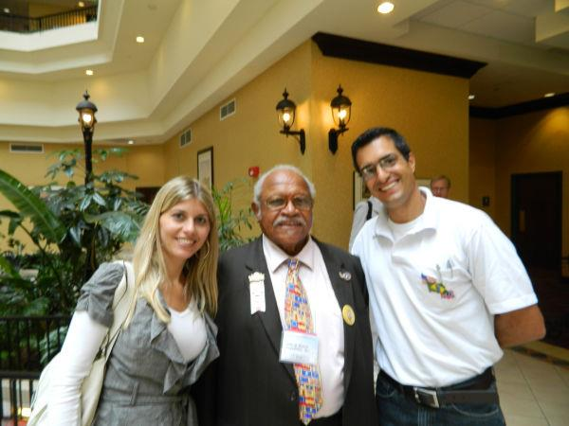
Marcelo and Giovanna Dodson with Nelson Winbush attending the 2011 SCV National Reunion held at Montgomery, AL. Marcelo is an officer in Camp #1653.

Slide 77
From SCV Camp 1653’s web page:
“is dedicated to those who left their homes and their country, moving to a faraway land to rebuild their lives after the War Between the States. Our ancestors will always have our undying reverence and our admiration for their courage, their braveness, and their loyalty to the Confederacy. We pledge to keep their memory, and to pass this reverence to our future generations, and whilst recognizing and abiding to the Brazilian and American Constitutions, we will not accept any distortion of the History of The Confederate States of America by any individual, group, or institution whatsoever.”
Notes:
Why do you suppose they recognize and abide to not only the Brazilian Constitution, but also the American?
Speculation: 1) Our Confederate ancestors loved the pre-WBTS Constitution of the U.S. with the principles established by their forefathers. To recognize it, would be to honor our their ancestors.
2) There may be members of the Os Confederados Camp 1653 who live in the U.S. and must also honor the Constitution of the U.S.
3) Above, is purely speculation

Slide 78
I greatly appreciate the SCV Camp #1653 "Os Confederados” for doing their outstanding part to fulfill “the Charge” in Brazil and for providing much of the information for this presentation.
http://confederados.com.br/
I also want to thank you for allowing me to present to you this small part of our Confederate History.
Questions?

Slide 79
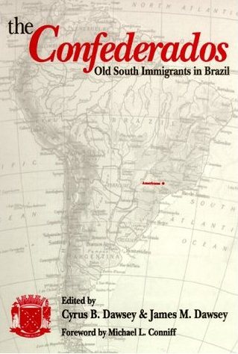
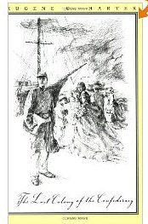

Slide 80
Resources for further study
The Lost Colony of the Confederacy, by Eugene Harter
Excellent short video resources on YouTube at:
https://www.youtube.com/watch?v=9l5ILYQAC1I&list=PLEBC987EEA9327F15
https://www.youtube.com/watch?v=fVJrv5V-uMY
The Confederados, Old South Immigrants in Brazil, by Cyrus Dawsey and James Dawsey

Slide 81
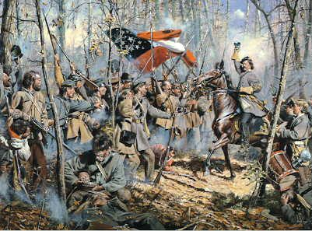
“The men in gray, who, with matchless courage, fought to maintain the principles of the Constitution and perpetuate the Government established by their fathers, and whose heroic deeds crowned the South with deathless glory.”
Robert Catlett Cave Confederate Veteran, Author, and Pastor
1843-1924
Deo Vindice!

